Slide 1
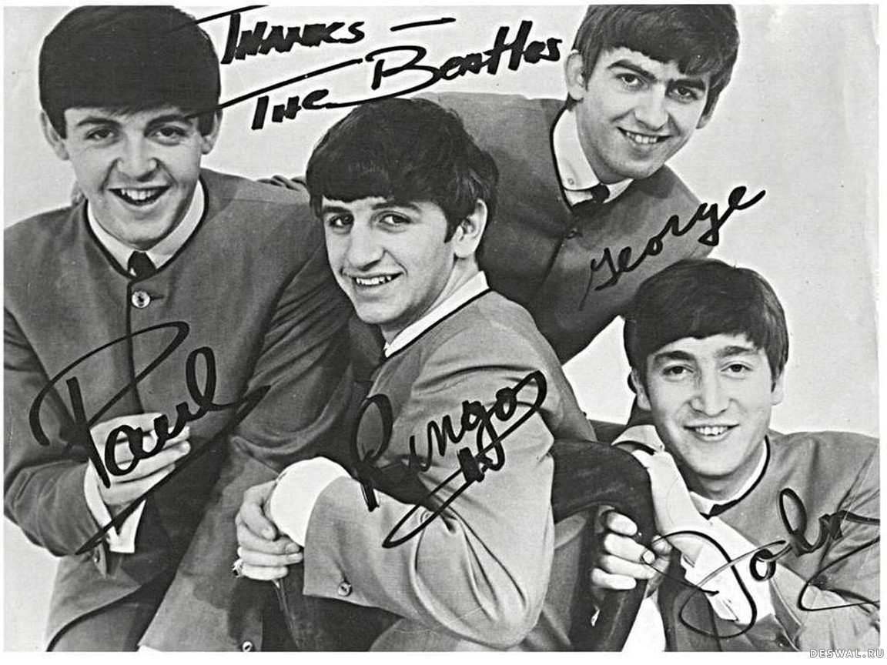
1. The Beatles were formed in March of 1957 by 16-year-old John Lennon and several friends. First called the Blackjacks, and later the Quarrymen, Paul McCartney joined the band later the same year, after hearing them play at a church social. By early 1958, George Harrison had joined. They toured off and on for the next several years, eventually adding a fourth guitarist, Stu Sutcliffe, who was slated to play bass. They lacked a consistent drummer until Pete Best was hired in 1960. Shortly after this, the Quarrymen, now going by the name The Beatles, left for Germany where they were slated to play as the house band in a number of clubs operated by the same owner. They performed in Germany for much of the next two years, and played as the backing band for a German pop star named Tony Sheridan. Sheridan's song "My Bonnie" - credited to Tony Sheridan & The Beat Brothers - charted at #32 in Germany, giving the band their first hit. Sutcliffe had left the band shortly before this time, and McCartney had taken over bass guitar duties.
What was the second name of the group?
The Beat Brothers
The Blackjacks
The Beatles
The Quarrymen

Slide 2
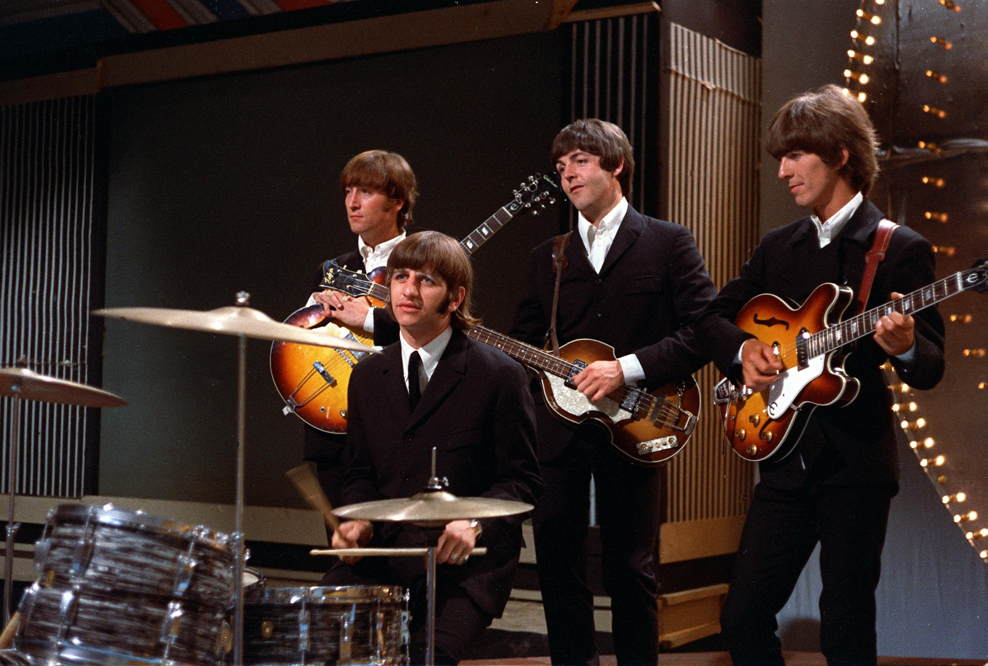
2. The Beatles are talked about as one of the best bands of all times but surprisingly none of The Beatles could even read music! Although they could play the guitar, and wrote their own lyrics, they never learned how to read music.
They did know the chords and knew where middle C was on a piano. In a 1980 interview with Playboy, John Lennon said: “I think Paul and Ringo stand up with any of the rock musicians. Not technically great — none of us are technical musicians. None of us could read music. None of us can write it. But as pure musicians, as inspired humans to make the noise, they are as good as anybody”
Paul is the only one of The Beatles who attempted to learn how to read music. He tried to take piano lessons from his girlfriend’s mother but did not have the time or the patience. None of the others even tried.
Who took some piano lessons?
Lennon
Ringo Starr
McCartney
Harrison

Slide 3
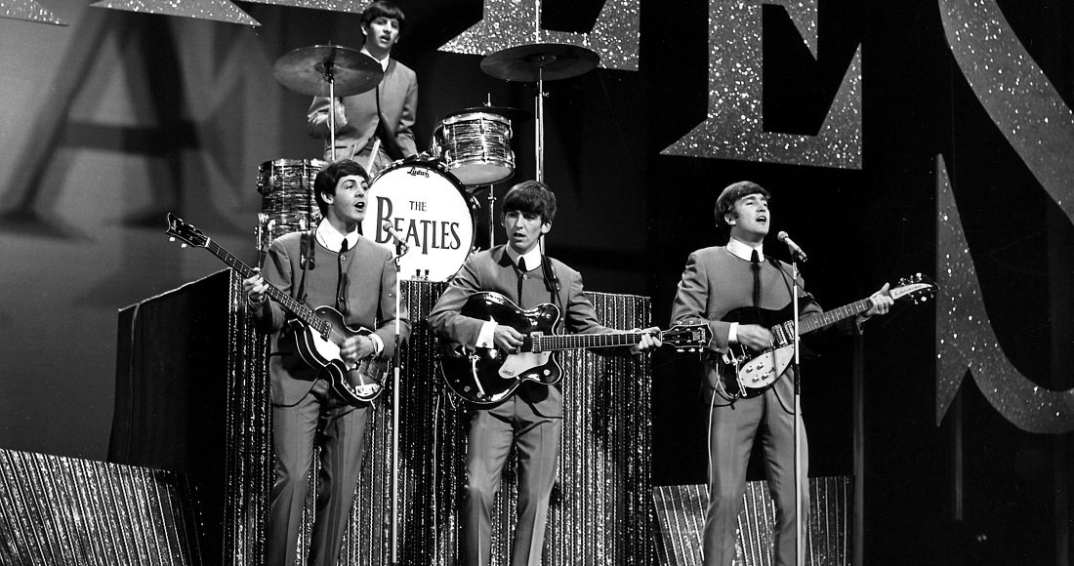
3. The Beatles are the only artists to hold all of the Top Five spots on the Billboard charts at once.
During the week of April 4, 1964, The Beatles held twelve positions on the Billboard Hot 100 singles chart, including the top five positions. Neither feat has been matched by any artist to date.
Since you’re surely wondering, here are those 12 singles and their chart positions that week:
“Can’t Buy Me Love” (1) “Twist and Shout” (2) “She Loves You” (3) “I Want to Hold Your Hand” (4)
“Please Please Me” (5) “I Saw Her Standing There” (31) “From Me to You” (41)
“Do You Want to Know a Secret” (46) “All My Loving” (58) “You Can’t Do That” (65)
“Roll Over Beethoven” (68) “Thank You Girl” (79)
The following week, two additional songs made the chart (“Love Me Do” and “There’s a Place”)! They also held the top two slots on the album charts that week.
How many positions on the Billboard Hot 100 singles chart did The Beatles take during the week of April 11, 1964?
12
14
13
2

Slide 4

4. Guess the name of the song by the Beatles that has been covered over 1,600 times.
In 1986 it held the record for most recorded song. It has been covered by Elvis Presley, Boyz II Men, Frank Sinatra, Gladys Knight, and James Brown. The song reportedly came to Paul McCartney in a dream and when he first played it, he wasn't sure if he had already heard it before. So even the writer of the song almost thought he was doing cover.
The Girl
Yesterday
Yellow Submarine
Can’t Buy Me Love

Slide 5
Пройдите увлекательный квест про Битлз на сайте https://www.learnis.ru/348136/ и послушайте одну из самых известных песен группы. Пойте вместе!

